Slide 1
Lecture 9
Develop Schedule
Notes:
Chapter 4
PROJECT integration MANAGEMENT

Slide 2
Develop Schedule
Develop Schedule is the Process of analyzing activity sequences, durations, resource requirements, and schedule constraints to create the project schedule model.
The key benefit of this process is that by entering schedule activities, durations, resources, resource availabilities, and logical relationships into the scheduling tool, it generates a schedule model with planned dates for completing project activities..
Notes:
Chapter 5
PROJECT SCOPE MANAGEMENT
SCOPE MANAGEMENT PLAN
Guidelines for how scope is to be managed and how scope changes are to be integrated into the project
It includes:
An assessment of the stability of the project scope
A clear description of how scope changes will be identified and classified

Slide 3
Develop Schedule
Process of analyzing activity sequences, durations, resource requirements, and schedule constraints to create the project schedule model.
Inputs
1
Tools and Techniques
2
Outputs
3
Schedule Management Plan
Activity List
Activity Attributes
Project Schedule Network Diagrams
Activity Resource Requirements
Resource Calendars
Activity Duration Estimates
Project Scope Statement
Risk Register
Project Staff assignments
Resource Breakdown Structure
Enterprise Environmental Factors
Organizational Process Assets
____________
Schedule Network Analysis
Critical Path Method
Critical Chain Method
Resource Optimization Techniques
Modeling Techniques
Leads and Lags
Schedule Compression
Scheduling Tools
____________
Schedule Baseline
Project Schedule
Schedule Data
Project Calendars
Project Management Plan updates
Project Documents Updates
____________
Notes:
Picture with three text columns
(Intermediate)
To reproduce the picture effects on this slide, do the following:
On the Home tab, in the Slides group, click Layout, and then click Blank.
On the Insert tab, in the Illustrations group, click Picture.
In the Insert Picture dialog box, select a picture and then click Insert.
Select the picture. Under Picture Tools, on the Format tab, in the bottom right corner of the Size group, click the Size and Position dialog box launcher.
In the Size and Position dialog box, on the Size tab, resize or crop the picture as needed so that under Size and rotate, the Height box is set to 1.48” and the Width box is set to 9.17”. Resize the picture under Size and rotate by entering values into the Height and Width boxes. Crop the picture under Crop from by entering values into the Left, Right, Top, and Bottom boxes.
On the Home tab, in the bottom right corner of the Drawing group, click the Format Shape dialog box launcher. In the Format Shape dialog box, click Line Color in the left pane, select Gradient line in the right pane, and then do the following:
In the Type list, select Linear.
Click the button next to Direction, and then click Linear Up (second row, second option from the left).
Under Gradient stops, click Add or Remove until two stops appear in the drop-down list.
Also under Gradient stops, customize the gradient stops that you added as follows:
Select Stop 1 from the list, and then do the following:
In the Stop position box, enter 0%.
Click the button next to Color, and then under Theme Colors click White, Background 1 (first row, first option from the left).
Select Stop 2 from the list, and then do the following:
In the Stop position box, enter 100%.
Click the button next to Color, and then under Theme Colors click White, Background 1, Darker 25% (fourth row, first option from the left).
Also in the Format Shape dialog box, click Line Style in the left pane, and then in the right pane, in the Width box, enter 1 pt.
On the Home tab, in the Drawing group, click Shape Effects, point to Glow, and then do the following:
Under Glow Variations, select any option in the first row (5 pt glow options).
Point to More Glow Colors, and then under Theme Colors click White, Background 1, Darker 25% (fourth row, first option from the left).
On the Home tab, in the Drawing group, click Arrange, point to Align, and then click Align Center.
To reproduce the first column heading on this slide, do the following:
On the Home tab, in the Drawing group, click Shapes, and then under Rectangles, click Rectangle (first option from the left). On the slide, drag to draw a rectangle.
Under Drawing Tools, on the Format tab, in the Size group, do the following:
In the Shape Height box, enter 1”.
In the Shape Width box, enter 2.92”.
On the Home tab, in the bottom right corner of the Drawing group, click the Format Shape dialog box launcher. In the Format Shape dialog box, click Fill in the left pane, select Gradient fill in the right pane, and then do the following:
In the Type list, select Linear.
Click the button next to Direction, and then click Linear Down (first row, second option from the left).
Under Gradient stops, click Add or Remove until two stops appear in the drop-down list.
Also under Gradient stops, customize the gradient stops that you added as follows:
Select Stop 1 from the list, and then do the following:
In the Stop position box, enter 32%.
Click the button next to Color, and then under Theme Colors click Tan, Background 2 (first row, third option from the left).
Select Stop 2 from the list, and then do the following:
In the Stop position box, enter 100%.
Click the button next to Color, and then under Theme Colors click Tan, Background 2, Darker 25% (third row, third option from the left).
Also in the Format Shape dialog box, click Line Color in the left pane, select Gradient line in the Line Color pane, and then do the following:
In the Type list, select Linear.
Click the button next to Direction, and then click Linear Up (second row, second option from the left).
Under Gradient stops, click Add or Remove until two stops appear in the drop-down list.
Also under Gradient stops, customize the gradient stops that you added as follows:
Select Stop 1 from the list, and then do the following:
In the Stop position box, enter 0%.
Click the button next to Color, and then under Theme Colors click White, Background 1 (first row, first option from the left).
Select Stop 2 from the list, and then do the following:
In the Stop position box, enter 100%.
Click the button next to Color, and then under Theme Colors click White, Background 1, Darker 25% (fourth row, first option from the left).
Also in the Format Shape dialog box, click Line Style in the left pane. In the right pane, in the Width box, enter 1 pt.
On the Home tab, in the Drawing group, click Shape Effects, point to Glow, and then do the following:
Under Glow Variations, select any option in the first row (5 pt glow options).
Point to More Glow Colors, and then under Theme Colors click White, Background 1, Darker 25% (fourth row, first option from the left).
On the slide, right-click the rectangle and then click Edit Text.
Enter text in the text box and select the text. On the Home tab, in the Font group, select Gill Sans MT from the Font list and then select 24 from the Font Size list.
On the Home tab, in the Paragraph group, click Align Text Left to align the text left within the text box.
Under Drawing Tools, on the Format tab, in the WordArt Styles group, click the arrow next to Text Fill, and then under Theme Colors click Tan, Background 2, Darker 75% (fifth row, third option from the left).
On the Home tab, in the bottom-right corner of the Drawing group, click the Format Shapes dialog box launcher. In the Format Shapes dialog box, click Text Box in the left pane. In the right pane, under Internal margin, enter 1” in the Left box to increase the left margin in the rectangle to accommodate the embossed number.
On the Home tab, in the Drawing group, click Shapes, and then under Lines, click Line (first option from the left).
Press and hold SHIFT, and then on the slide, drag to draw a straight, vertical line.
Under Drawing Tools, on the Format tab, in the Size group, in the Width box, enter 0.75”.
On the Home tab, in the bottom-right corner of the Drawing group, click the Format Shapes dialog box launcher. In the Format Shapes dialog box, click Line Style in the left pane, and then do the following in the right pane:
In the Width box, enter 2.25 pt.
Click the button next to Dash type, and then click Round Dot (second option from the top).
Also in the Format Shapes dialog box, click Line Color in the left pane. In the right pane, click the button next to Color, and then under Theme Colors click White, Background 1 (first row, first option from the left).
On the slide, drag the line onto the rectangle, just left of the text box.
On the Insert tab, in the Text box, click Text Box and then on the slide, drag to draw another text box.
Enter 1 in the text box and select the text. On the Home tab, in the Font group, select Calisto MT from the Font list and then enter 50 in the Font Size box.
On the Home tab, in the Paragraph group, click Center to center the text within the text box.
Under Drawing Tools, on the Format tab, in the WordArt Styles group, click the arrow next to Text Fill, and then under Theme Colors click Tan, Background 2, Darker 25% (third row, third option from the left).
Drag the text box onto the rectangle, left of the dotted vertical line.
On the Home tab, in the Editing group, click Select, and then click Selection Pane.
In the Selection and Visibility pane, press and hold CTRL to select the text box, line, and rectangle.
On the Home tab, in the Drawing group, click Arrange, point to Align, and then click Align Middle.
To reproduce the other column headings on this slide, do the following:
On the Home tab, in the Editing group, click Select, and then click Selection Pane.
In the Selection and Visibility pane, press and hold CTRL to select the text box, line, and rectangle.
On the Home tab, in the Drawing group, click Arrange, and then under Group Objects click Group.
On the Home tab, in the Clipboard group, click the arrow under Paste, and then click Duplicate. Repeat the process until you have a total of three groups of shapes.
Select each group in the Selection and Visibility pane and drag it on the slide to form a row under the picture.
Also in the Selection and Visibility pane, press and hold CTRL and select all three groups. On the Home tab, in the Drawing group, click Arrange, point to Align, and then do the following:
Click Align Middle.
Click Distribute Horizontally.
To change the numbers in the duplicate text boxes (second and third from the left), click in each text box and edit the text.
To reproduce the first column (the “subtext” portion) on this slide, do the following:
On the Home tab, in the Drawing group, click Shapes, and then under Rectangles click Rectangle (first option from the left).
On the slide, drag to draw the rectangle so that the top edge is just below the first column heading and the bottom edge is at the bottom of the slide.
Under Drawing Tools, on the Format tab, in the Size group, in the Shape Width box, enter 2.92” so that the subtext column is the same width as the column heading above it.
On the Home tab, in the Drawing group, click the arrow next to Shape Outline, and then click No Outline.
On the Home tab, in the bottom right corner of the Drawing group, click the Format Shape dialog box launcher. In the Format Shape dialog box, click Fill in the left pane, select Gradient fill in the right pane, and then do the following:
In the Type list, select Linear.
Click the button next to Direction, and then click Linear Down (first row, second option from the left).
Under Gradient stops, click Add or Remove until three stops appear in the drop-down list.
Also under Gradient stops, customize the gradient stops that you added as follows:
Select Stop 1 from the list, and then do the following:
In the Stop position box, enter 0%.
Click the button next to Color, and then under Theme Colors click White, Background 1 (first row, first option from the left).
In the Transparency box, enter 100%.
Select Stop 2 from the list, and then do the following:
In the Stop position box, enter 50%.
Click the button next to Color, and then under Theme Colors click Tan, Background 2, Darker 25% (third row, third option from the left).
In the Transparency box, enter 25%.
Select Stop 3 from the list, and then do the following:
In the Stop position box, enter 100%.
Click the button next to Color, and then under Theme Colors click White, Background 1 (first row, first option from the left).
In the Transparency box, enter 100%.
On the slide, right-click the column and then click Edit Text.
Enter text in the text box and select the text. On the Home tab, in the Font group, select Gill Sans MT from the Font list and then enter 22 in the Font Size box.
On the Home tab, in the Paragraph group, click Center to center the text within the rectangle.
Under Drawing Tools, on the Format tab, in the WordArt Styles group, click the arrow next to Text Fill, and then under Theme Colors click White, Background 1, Darker 50% (sixth row, first option from the left).
On the Home tab, in the bottom-right corner of the Drawing group, click the Format Shapes dialog box launcher. In the Format Shapes dialog box, click Text Box in the left pane. In the right pane, under Text layout, in the Vertical Alignment list, select Top.
To reproduce the other columns (the “subtext” portion) on this slide, do the following:
Select the first “subtext” rectangle. On the Home tab, in the Clipboard group, click the arrow under Paste, and then click Duplicate. Repeat the process until you have a total of three “subtext” rectangles.
Drag each duplicate on the slide to form a row under the “text heading” rectangles.
Press and hold SHIFT and select all three “subtext” rectangles. On the Home tab, in the Drawing group, click Arrange, point to Align, and then click Distribute Horizontally.
To reproduce the background on this slide, do the following:
Right-click the slide background area, and then click Format Background. In the Format Background dialog box, click Fill in the left pane, select Gradient fill in the right pane, and then do the following:
In the Type list, select Radial.
Click the button next to Direction, and then click From Center (third option from the left).
Under Gradient stops, click Add or Remove until two stops appear in the drop-down list.
Also under Gradient stops, customize the gradient stops that you added as follows:
Select Stop 1 from the list, and then do the following:
In the Stop position box, enter 0%.
Click the button next to Color, and then under Theme Colors click White, Background 1 (first row, first option from the left).
Select Stop 2 from the list, and then do the following:
In the Stop position box, enter 100%.
Click the button next to Color, and then under Theme Colors click Tan, Background 2 (first row, third option from the left).

Slide 4
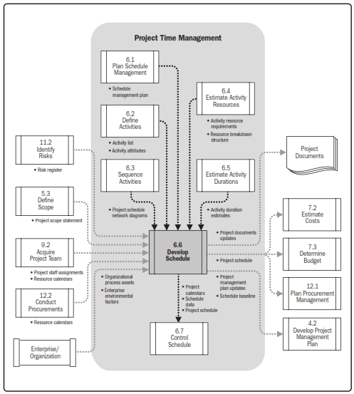
Develop Schedule

Slide 5
Develop Schedule
INPUTS
Schedule Management Plan
Activity List
Activity Attributes
Project Schedule Network Diagrams
Activity Resource Requirements
Resource Calendars
Activity Duration Estimates
Project Scope Statement
Risk Register
Project Staff Assignments
Resource Breakdown Structure
Enterprise Environmental Factors
Organizational Process Assets
Notes:
Topic 4.1.1
DEVELOP PROJECT CHARTER - INPUTS
4.1.1.1 Project Statement of Work
4.1.1.2 Business Case
4.1.1.3 Agreements
4.1.1.4 Enterprise Environmental Factors
4.1.1.4 Organizational Process Assets

Slide 6
Develop Schedule
INPUTS
6.6.1.1 Schedule Management Plan
Notes:
Topic 4.1.1
DEVELOP PROJECT CHARTER - INPUTS
4.1.1.1 Project Statement of Work
4.1.1.2 Business Case
4.1.1.3 Agreements
4.1.1.4 Enterprise Environmental Factors
4.1.1.4 Organizational Process Assets

Slide 7
Develop Schedule
INPUTS
6.6.1.2 Activity List
Notes:
Topic 4.1.1
DEVELOP PROJECT CHARTER - INPUTS
4.1.1.1 Project Statement of Work
4.1.1.2 Business Case
4.1.1.3 Agreements
4.1.1.4 Enterprise Environmental Factors
4.1.1.4 Organizational Process Assets

Slide 8
Develop Schedule
INPUTS
6.6.1.3 Activity Attributes
Notes:
Topic 4.1.1
DEVELOP PROJECT CHARTER - INPUTS
4.1.1.1 Project Statement of Work
4.1.1.2 Business Case
4.1.1.3 Agreements
4.1.1.4 Enterprise Environmental Factors
4.1.1.4 Organizational Process Assets

Slide 9
Develop Schedule
INPUTS
6.6.1.4 Project Schedule Network Diagrams
Notes:
Topic 4.1.1
DEVELOP PROJECT CHARTER - INPUTS
4.1.1.1 Project Statement of Work
4.1.1.2 Business Case
4.1.1.3 Agreements
4.1.1.4 Enterprise Environmental Factors
4.1.1.4 Organizational Process Assets

Slide 10
Develop Schedule
INPUTS
6.6.1.5 Activity Resource Requirements
Notes:
Topic 4.1.1
DEVELOP PROJECT CHARTER - INPUTS
4.1.1.1 Project Statement of Work
4.1.1.2 Business Case
4.1.1.3 Agreements
4.1.1.4 Enterprise Environmental Factors
4.1.1.4 Organizational Process Assets

Slide 11
Develop Schedule
INPUTS
6.6.1.6 Resource Calendars
Notes:
Topic 4.1.1
DEVELOP PROJECT CHARTER - INPUTS
4.1.1.1 Project Statement of Work
4.1.1.2 Business Case
4.1.1.3 Agreements
4.1.1.4 Enterprise Environmental Factors
4.1.1.4 Organizational Process Assets

Slide 12
Develop Schedule
INPUTS
6.6.1.7 Activity Duration Estimates
Notes:
Topic 4.1.1
DEVELOP PROJECT CHARTER - INPUTS
4.1.1.1 Project Statement of Work
4.1.1.2 Business Case
4.1.1.3 Agreements
4.1.1.4 Enterprise Environmental Factors
4.1.1.4 Organizational Process Assets

Slide 13
Develop Schedule
INPUTS
6.6.1.8 Project Scope Statement
Notes:
Topic 4.1.1
DEVELOP PROJECT CHARTER - INPUTS
4.1.1.1 Project Statement of Work
4.1.1.2 Business Case
4.1.1.3 Agreements
4.1.1.4 Enterprise Environmental Factors
4.1.1.4 Organizational Process Assets

Slide 14
Develop Schedule
INPUTS
6.6.1.9 Risk Register
Notes:
Topic 4.1.1
DEVELOP PROJECT CHARTER - INPUTS
4.1.1.1 Project Statement of Work
4.1.1.2 Business Case
4.1.1.3 Agreements
4.1.1.4 Enterprise Environmental Factors
4.1.1.4 Organizational Process Assets

Slide 15
Develop Schedule
INPUTS
6.6.1.10 Project Staff Assignments
Notes:
Topic 4.1.1
DEVELOP PROJECT CHARTER - INPUTS
4.1.1.1 Project Statement of Work
4.1.1.2 Business Case
4.1.1.3 Agreements
4.1.1.4 Enterprise Environmental Factors
4.1.1.4 Organizational Process Assets

Slide 16
Develop Schedule
INPUTS
6.6.1.11 Resource Breakdown Structure
Notes:
Topic 4.1.1
DEVELOP PROJECT CHARTER - INPUTS
4.1.1.1 Project Statement of Work
4.1.1.2 Business Case
4.1.1.3 Agreements
4.1.1.4 Enterprise Environmental Factors
4.1.1.4 Organizational Process Assets

Slide 17
Develop Schedule
INPUTS
6.6.1.12 Enterprise Environmental Factors
Notes:
Topic 4.1.1
DEVELOP PROJECT CHARTER - INPUTS
4.1.1.1 Project Statement of Work
4.1.1.2 Business Case
4.1.1.3 Agreements
4.1.1.4 Enterprise Environmental Factors
4.1.1.4 Organizational Process Assets

Slide 18
Develop Schedule
INPUTS
6.6.1.13 Organizational Process Assets
Notes:
Topic 4.1.1
DEVELOP PROJECT CHARTER - INPUTS
4.1.1.1 Project Statement of Work
4.1.1.2 Business Case
4.1.1.3 Agreements
4.1.1.4 Enterprise Environmental Factors
4.1.1.4 Organizational Process Assets

Slide 19
Develop Schedule
Tools & Techniques
Schedule Network Analysis
Critical Path Method
Critical Chain Method
Resource Optimization Techniques
Modeling Techniques
Leads and Lags
Schedule Compression
Scheduling Tools
Notes:
Topic 4.1.1
DEVELOP PROJECT CHARTER - INPUTS
4.1.1.1 Project Statement of Work
4.1.1.2 Business Case
4.1.1.3 Agreements
4.1.1.4 Enterprise Environmental Factors
4.1.1.4 Organizational Process Assets

Slide 20
Develop Schedule
Tools & Techniques
6.6.2.1 Schedule Network Analysis
Notes:
Topic 4.1.1
DEVELOP PROJECT CHARTER - INPUTS
4.1.1.1 Project Statement of Work
4.1.1.2 Business Case
4.1.1.3 Agreements
4.1.1.4 Enterprise Environmental Factors
4.1.1.4 Organizational Process Assets

Slide 21
Schedule Network Analysis
A technique used by project managers to analyze schedule information and generate realistic and optimal project schedules.
This analysis should be performed upon completion of the draft schedule and network diagram and after each schedule update.
It involves:
Identifying the schedule impact of task dependencies
Identifying critical path tasks and understanding the impact of the critical path on the schedule.
Analyzing the effects of schedule constraints and externally imposed dates
Understanding which tasks can experience delays without delaying the overall schedule
Conducting “what if” analysis of various activity durations (for example, what if the testing activities take twice as long as is currently planned?)
Assessing resource allocation and leveling to prevent resource over-allocation
Assessing fast tracking or crashing options

Slide 22
Develop Schedule
Tools & Techniques
6.6.2.4 Resource Optimization Techniques
Notes:
Topic 4.1.1
DEVELOP PROJECT CHARTER - INPUTS
4.1.1.1 Project Statement of Work
4.1.1.2 Business Case
4.1.1.3 Agreements
4.1.1.4 Enterprise Environmental Factors
4.1.1.4 Organizational Process Assets

Slide 23
Resource Leveling
Resource leveling is the process of changing schedule resource allocation to resolve over-allocations or conflicts. Resource leveling is applied to a schedule that has already been analyzed by the critical path method. This technique is used to adjust a project schedule if shared resources are only available at certain times, or in limited quantities, or if a Project Manager wants to maintain resource usage at a constant level. Resource leveling is often used to correct resource over-allocations and will often change the critical path. The network diagram should be recreated after resource leveling to assess the updated critical path.

Slide 24
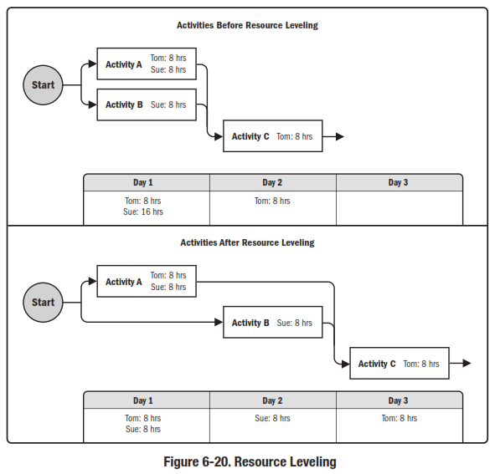
Develop Schedule
Tools & Techniques
6.6.2.4 Resource Optimization Techniques
Notes:
Topic 4.1.1
DEVELOP PROJECT CHARTER - INPUTS
4.1.1.1 Project Statement of Work
4.1.1.2 Business Case
4.1.1.3 Agreements
4.1.1.4 Enterprise Environmental Factors
4.1.1.4 Organizational Process Assets

Slide 25
Develop Schedule
Tools & Techniques
6.6.2.4 Resource Optimization Techniques
Notes:
Topic 4.1.1
DEVELOP PROJECT CHARTER - INPUTS
4.1.1.1 Project Statement of Work
4.1.1.2 Business Case
4.1.1.3 Agreements
4.1.1.4 Enterprise Environmental Factors
4.1.1.4 Organizational Process Assets

Slide 26
Develop Schedule
Tools & Techniques
6.6.2.6 Leads and Lags
Notes:
Topic 4.1.1
DEVELOP PROJECT CHARTER - INPUTS
4.1.1.1 Project Statement of Work
4.1.1.2 Business Case
4.1.1.3 Agreements
4.1.1.4 Enterprise Environmental Factors
4.1.1.4 Organizational Process Assets

Slide 27
Schedule Compression Techniques
As a result of network diagram analysis, project teams may identify a need to compress the schedule. Schedule compression shortens the project schedule in order to meet schedule deadlines without reducing the project scope. Schedule compression techniques include crashing and fast tracking. If utilized, project teams should recreate and reassess the network diagram to ensure that no new schedule issues have emerged.

Slide 28
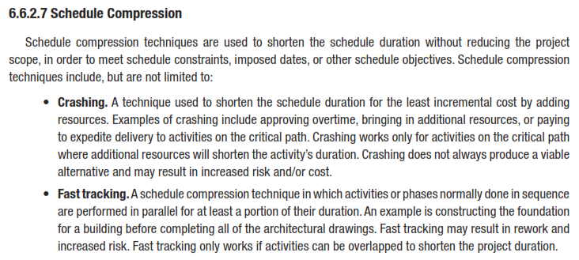
Develop Schedule
Tools & Techniques
6.6.2.7 Schedule Compression
Notes:
Topic 4.1.1
DEVELOP PROJECT CHARTER - INPUTS
4.1.1.1 Project Statement of Work
4.1.1.2 Business Case
4.1.1.3 Agreements
4.1.1.4 Enterprise Environmental Factors
4.1.1.4 Organizational Process Assets

Slide 29
Crashing
Crashing involves either adding resources or increasing work hours (overtime, weekends) to shorten task duration. Shorter task durations typically result in higher task costs, so project teams must determine, prior to crashing, whether the total costs savings is enough to justify the higher costs. Crashing almost always requires cost increases because it usually necessitates new tasks. Crashing is a controversial technique because adding project resources can increase project complexity or risk and may ultimately have a negative impact on the schedule. Crashing does not involve reducing project scope or eliminating project tasks.

Slide 30
Fast Tracking
Fast tracking is a schedule compression technique in which project phases or activities usually conducted sequentially are performed in parallel to reduce duration. Care must be taken to ensure that parallel work does not create additional work or increase risk. Fast tracking frequently results in increased complexities in task dependencies, so additional project controls must be implemented to ensure ongoing and accurate insight into schedule performance

Slide 31
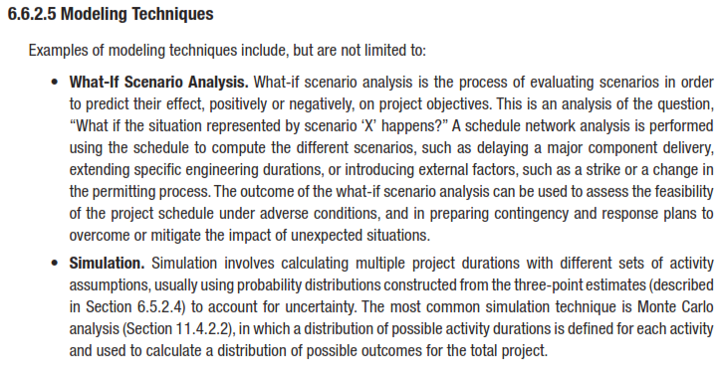
Develop Schedule
Tools & Techniques
6.6.2.5 Modeling Techniques
Notes:
Topic 4.1.1
DEVELOP PROJECT CHARTER - INPUTS
4.1.1.1 Project Statement of Work
4.1.1.2 Business Case
4.1.1.3 Agreements
4.1.1.4 Enterprise Environmental Factors
4.1.1.4 Organizational Process Assets

Slide 32
What-If Scenario Analysis
This analysis examines the schedule impact of various scenarios, such as the delayed delivery of a major deliverable. What-if scenario analysis may include simulation that calculates multiple project durations with different sets of activity assumptions. Multiple network diagrams may be generated to visually convey the impact of varying scenarios. Project managers can use the results of this analysis to determine schedule feasibility under adverse conditions and prepare relevant contingency plans

Slide 33
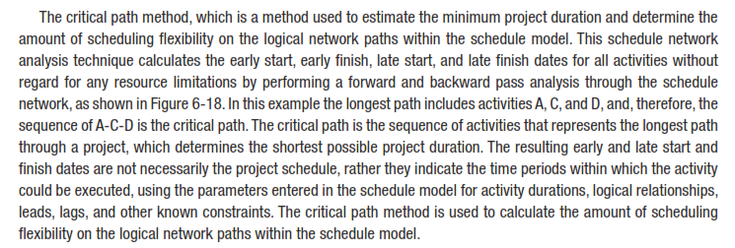
Develop Schedule
Tools & Techniques
Critical Path Method
Notes:
Topic 4.1.1
DEVELOP PROJECT CHARTER - INPUTS
4.1.1.1 Project Statement of Work
4.1.1.2 Business Case
4.1.1.3 Agreements
4.1.1.4 Enterprise Environmental Factors
4.1.1.4 Organizational Process Assets

Slide 34
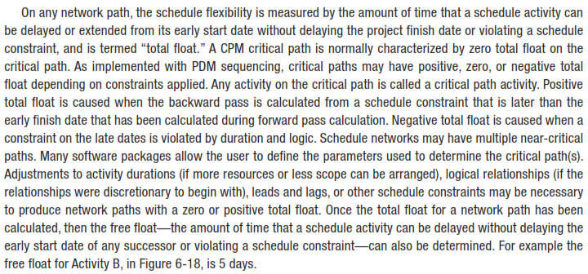
Develop Schedule
Tools & Techniques
Critical Path Method
Notes:
Topic 4.1.1
DEVELOP PROJECT CHARTER - INPUTS
4.1.1.1 Project Statement of Work
4.1.1.2 Business Case
4.1.1.3 Agreements
4.1.1.4 Enterprise Environmental Factors
4.1.1.4 Organizational Process Assets

Slide 35
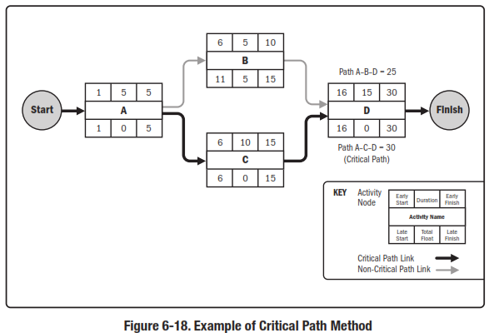
Develop Schedule
Tools & Techniques
6.6.2.2 Critical Path Method
Notes:
Topic 4.1.1
DEVELOP PROJECT CHARTER - INPUTS
4.1.1.1 Project Statement of Work
4.1.1.2 Business Case
4.1.1.3 Agreements
4.1.1.4 Enterprise Environmental Factors
4.1.1.4 Organizational Process Assets

Slide 36
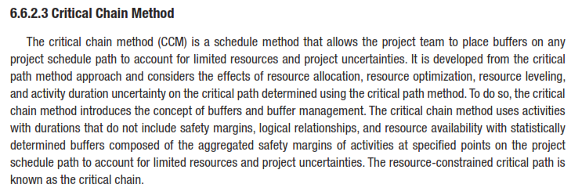
Develop Schedule
Tools & Techniques
Critical Chain Method
Notes:
Topic 4.1.1
DEVELOP PROJECT CHARTER - INPUTS
4.1.1.1 Project Statement of Work
4.1.1.2 Business Case
4.1.1.3 Agreements
4.1.1.4 Enterprise Environmental Factors
4.1.1.4 Organizational Process Assets

Slide 37
Develop Schedule
Tools & Techniques
Critical Chain Method
Notes:
Topic 4.1.1
DEVELOP PROJECT CHARTER - INPUTS
4.1.1.1 Project Statement of Work
4.1.1.2 Business Case
4.1.1.3 Agreements
4.1.1.4 Enterprise Environmental Factors
4.1.1.4 Organizational Process Assets

Slide 38
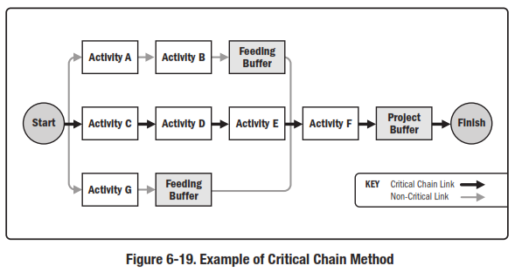
Develop Schedule
Tools & Techniques
Critical Chain Method
Notes:
Topic 4.1.1
DEVELOP PROJECT CHARTER - INPUTS
4.1.1.1 Project Statement of Work
4.1.1.2 Business Case
4.1.1.3 Agreements
4.1.1.4 Enterprise Environmental Factors
4.1.1.4 Organizational Process Assets

Slide 39
Develop Schedule
Tools & Techniques
Schedule Compression
Crashing. Schedule compression technique in which cost and schedule tradeoffs are analyzed to determine how to obtain the greatest amount of compression for the least incremental cost. Crashing does not always produce a viable alternative and can result in increased cost.
Fast tracking. A schedule compression technique in which phases or activities that normally would be done in sequence are performed in parallel. An example would be to construct the foundation for a building before all the architectural drawings are complete. Fast tracking can result in rework and increased risk. This approach can require work to be performed without completed detailed information, such as engineering drawings. It results in trading cost for time, and increases the risk of achieving the shortened project schedule.

Slide 40
Develop Schedule
Tools & Techniques
Scheduling Tools
Notes:
Topic 4.1.1
DEVELOP PROJECT CHARTER - INPUTS
4.1.1.1 Project Statement of Work
4.1.1.2 Business Case
4.1.1.3 Agreements
4.1.1.4 Enterprise Environmental Factors
4.1.1.4 Organizational Process Assets

Slide 41
Develop Schedule
OUTPUTS
Schedule Baseline
Project Schedule
Schedule Data
Project Calendars
Project Management Plan Updates
Project Documents Updates
Notes:
Topic 4.1.1
DEVELOP PROJECT CHARTER - INPUTS
4.1.1.1 Project Statement of Work
4.1.1.2 Business Case
4.1.1.3 Agreements
4.1.1.4 Enterprise Environmental Factors
4.1.1.4 Organizational Process Assets

Slide 42
Develop Schedule
OUTPUTS
6.6.3.1 Schedule Baseline
Notes:
Topic 4.1.1
DEVELOP PROJECT CHARTER - INPUTS
4.1.1.1 Project Statement of Work
4.1.1.2 Business Case
4.1.1.3 Agreements
4.1.1.4 Enterprise Environmental Factors
4.1.1.4 Organizational Process Assets

Slide 43
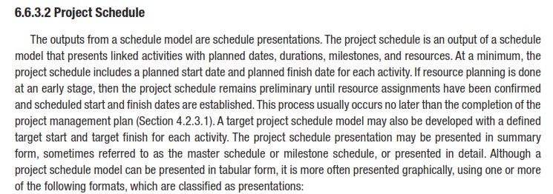
Develop Schedule
OUTPUTS
6.6.3.2 Project Schedule
Notes:
Topic 4.1.1
DEVELOP PROJECT CHARTER - INPUTS
4.1.1.1 Project Statement of Work
4.1.1.2 Business Case
4.1.1.3 Agreements
4.1.1.4 Enterprise Environmental Factors
4.1.1.4 Organizational Process Assets

Slide 44
Develop Schedule
OUTPUTS
6.6.3.2 Project Schedule
Notes:
Topic 4.1.1
DEVELOP PROJECT CHARTER - INPUTS
4.1.1.1 Project Statement of Work
4.1.1.2 Business Case
4.1.1.3 Agreements
4.1.1.4 Enterprise Environmental Factors
4.1.1.4 Organizational Process Assets

Slide 45
Develop Schedule
OUTPUTS
6.6.3.2 Project Schedule
Bar charts. These charts, with bars representing activities, show activity start and end dates, as well as expected durations.
Milestone charts. These charts are similar to bar charts, but only identify the scheduled start or completion of major deliverables and key external interfaces.
Project schedule network diagrams. These diagrams, with activity date information, usually show both the project network logic and the project’s critical path schedule activities.

Slide 46
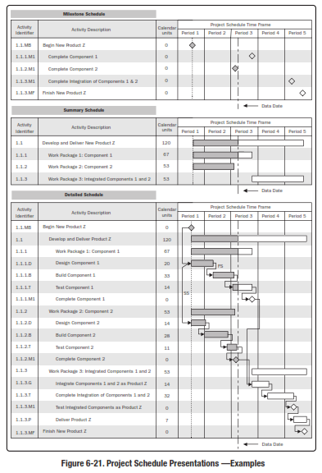
Develop Schedule
OUTPUTS
6.6.3.2 Project Schedule
Reference: Figure 6.21.
PMBOK® Guide, 5th Ed
Notes:
Topic 4.1.1
DEVELOP PROJECT CHARTER - INPUTS
4.1.1.1 Project Statement of Work
4.1.1.2 Business Case
4.1.1.3 Agreements
4.1.1.4 Enterprise Environmental Factors
4.1.1.4 Organizational Process Assets

Slide 47
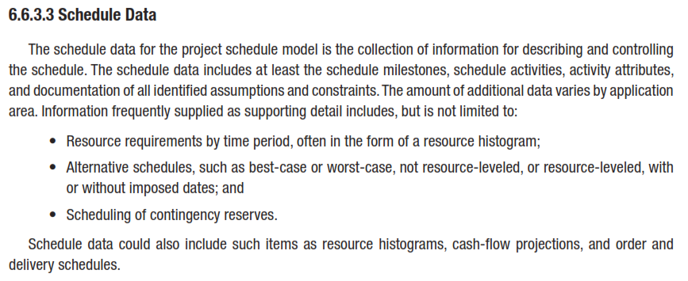
Develop Schedule
OUTPUTS
6.6.3.3 Schedule Data
Notes:
Topic 4.1.1
DEVELOP PROJECT CHARTER - INPUTS
4.1.1.1 Project Statement of Work
4.1.1.2 Business Case
4.1.1.3 Agreements
4.1.1.4 Enterprise Environmental Factors
4.1.1.4 Organizational Process Assets

Slide 48
Develop Schedule
OUTPUTS
6.6.3.3 Schedule Data
Supporting data for the project schedule includes at least the schedule milestones, schedule activities, activity attributes and documentation of all identified assumptions and constraints. The amount of additional data varies by application area. Information frequently supplied as supporting detail includes, but is not limited to:
Resource requirements by time period, often in the form of a resource histogram
Alternative schedules, such as best-case or worst-case, not resource leveled, resource leveled, with or without imposed dates
Schedule contingency reserves.

Slide 49
Develop Schedule
OUTPUTS
6.6.3.4 Project Calendars
Notes:
Topic 4.1.1
DEVELOP PROJECT CHARTER - INPUTS
4.1.1.1 Project Statement of Work
4.1.1.2 Business Case
4.1.1.3 Agreements
4.1.1.4 Enterprise Environmental Factors
4.1.1.4 Organizational Process Assets

Slide 50
Develop Schedule
OUTPUTS
6.6.3.5 Project Management Plan Updates
Notes:
Topic 4.1.1
DEVELOP PROJECT CHARTER - INPUTS
4.1.1.1 Project Statement of Work
4.1.1.2 Business Case
4.1.1.3 Agreements
4.1.1.4 Enterprise Environmental Factors
4.1.1.4 Organizational Process Assets

Slide 51
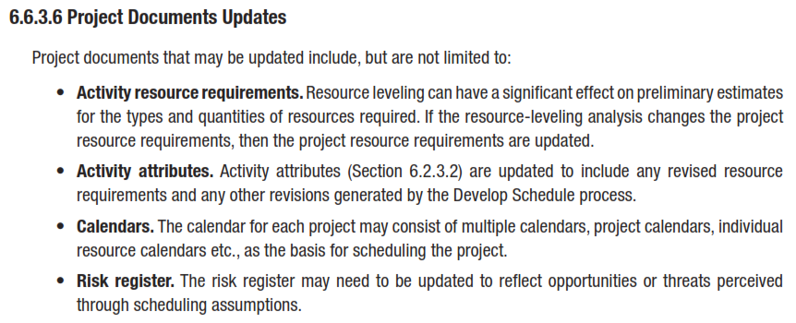
Develop Schedule
OUTPUTS
6.6.3.6 Project Documents Updates
Notes:
Topic 4.1.1
DEVELOP PROJECT CHARTER - INPUTS
4.1.1.1 Project Statement of Work
4.1.1.2 Business Case
4.1.1.3 Agreements
4.1.1.4 Enterprise Environmental Factors
4.1.1.4 Organizational Process Assets

